Slide 1


Customer Churn Prediction in Telecommunications
Archana AR

Slide 2
Problem Statement
Background:
A leading telecommunications company, is facing a significant challenge with customer churn. The company has been experiencing a high rate of customer attrition, leading to revenue loss and a decline in market share. To address this issue, it wants to implement a machine learning solution for predicting customer churn.
Objective:
The objective of this project is to develop a predictive model that can accurately identify customers who are likely to churn. By proactively identifying at-risk customers, the company aims to implement targeted retention strategies to reduce churn and improve customer satisfaction and loyalty.

Slide 3
What are the advantages of Customer Churn prediction
Increase Company’s Revenue
Improve Customer Experience
Retain Customers
Predicting for customer who are at risk of churning helps to avoid the loss of the customers by improving the customer experience. This in turn increases the company’s revenue

Slide 4
EXPLORATORY DATA ANALYSIS (EDA)

Slide 5
Understanding the Data
Age - The Age of the customer [Demographic information of the customer]
Gender- The Gender of the customer [Demographic information of the customer] (Male:0, Female:1)
Income – The income of the customer [Demographic information of the customer]
Account_Length – Period of association with the telecom provider (months)
Contract_Type- Type of contract that the customer has opted for (Features and associated services may vary accordingly) - Tier 1 (0), Tier 2 (1), Tier 3 (2) [Services the customer has signed up]
Call_Duration- Average call duration in minutes during a given day for the particular customer [Services the customer has used]
Data_Usage- Average data consumption during a given day for the particular customer [Services the customer has signed up]
Churn- Whether the individual will churn/not churn [Classification Label]
Assumptions about the data
1 represents Churned individuals
0 represents not-churned individuals
CustomerID unique identifier is created as not given in data set
Churn | Churn/Not Churn?
0 | Not-Churned
1 | Yes Churned

Slide 6
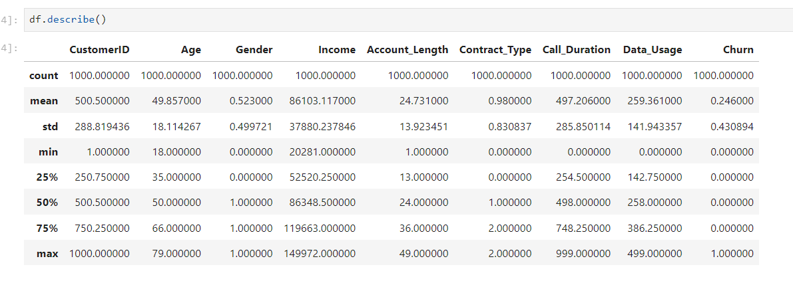
Understanding the Data (Contd.)
Some facts about the data
Age ranges between 18 years to 79 years
Income ranges between 20281 to 149972
Call duration ranges between 0 to 999
Data Usage ranges between 0 to 499
Gender, Contract_type are categorical

Slide 7
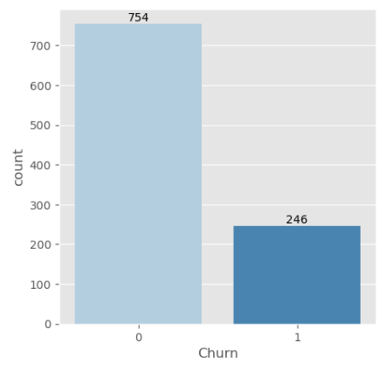
Churn Target Variable
Churn in current data points Vs Non Churned customers

Slide 8
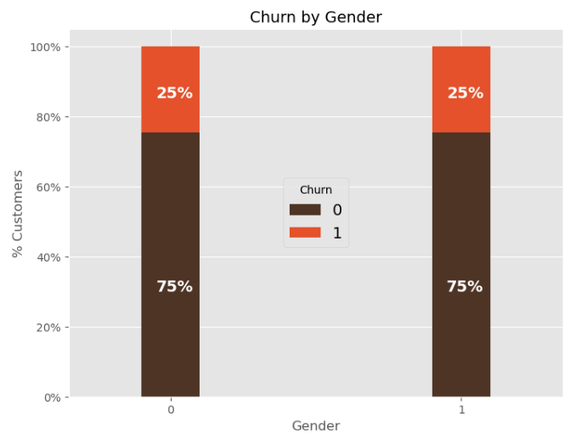
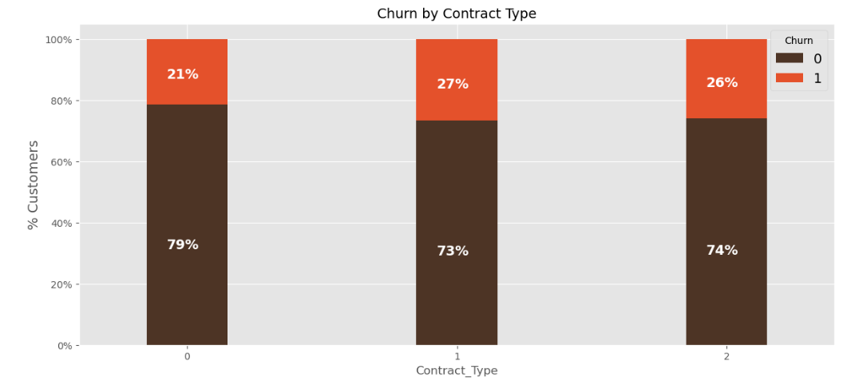
Churn Vs Features
Checking Churn with respect to features
Gender 2. Contract_type
As we can see Churn is more equally distributed for Gender. Regardless of the gender Churn can happen
Contract type Tier 1 have more retained customers compared to Tier 2 and Tier 3

Slide 9
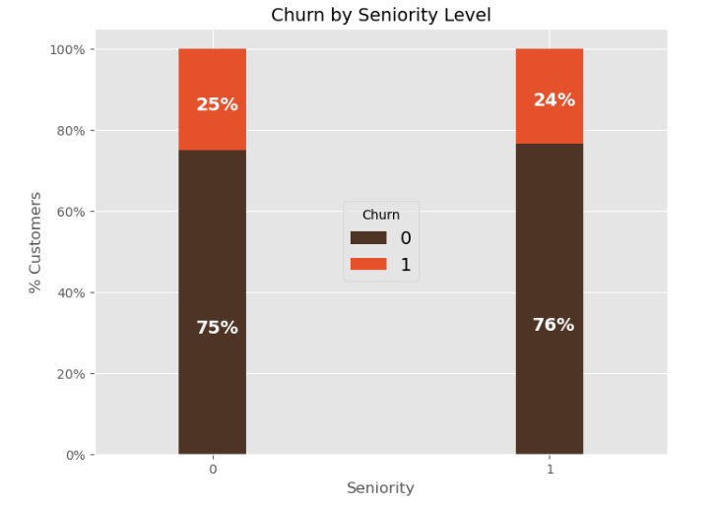
Churn Vs Features
Checking Churn with respect to features
3. Seniority Level
Consideration is person age >=60 is Senior Citizen , and if less than 60 he is normal citizen
There is just 1% reduction in churn when the customer is senior citizen

Slide 10
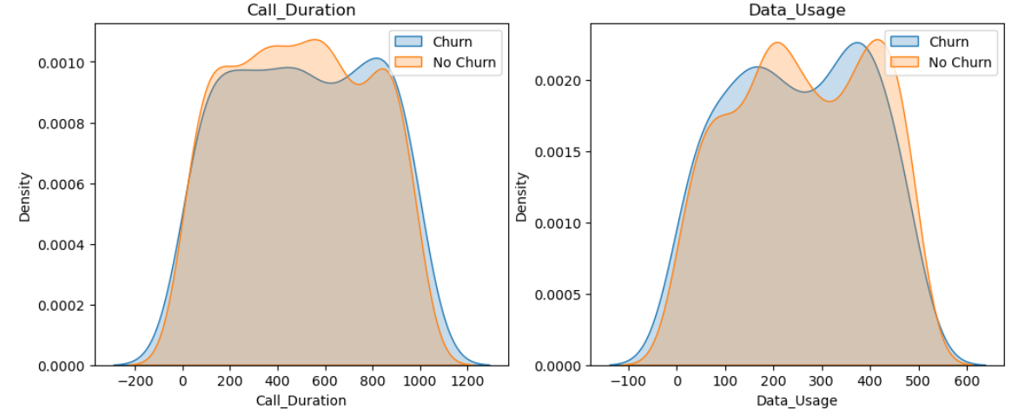
Churn Vs Features(Contd.)
Checking Churn with respect to features
Customers with high call duration are more likely to stay with the service provider
Customers with high data usage are more likely to stay with the service provider
3. Call Duration 4. Data Usage

Slide 11
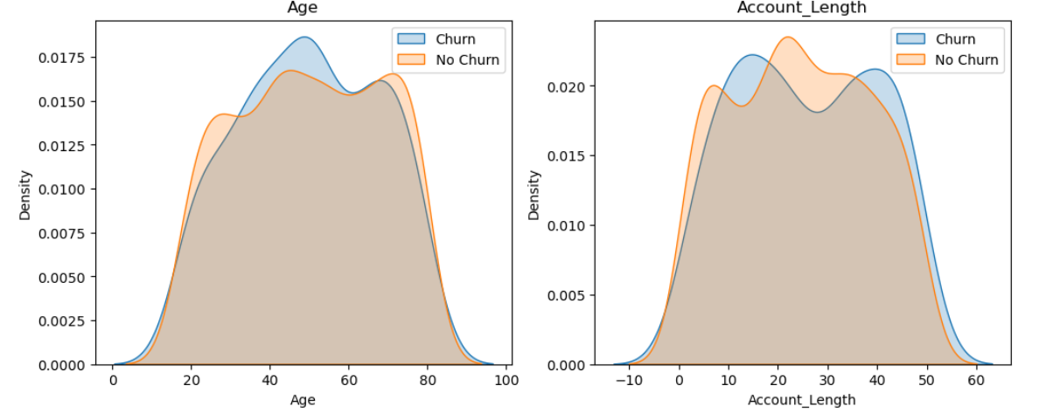
Churn Vs Features(Contd.)
Checking Churn with respect to features
Customers with high age are more likely to churn
Customers with high tenure with the service provider are more likely to stay with the service provider
5. Age 6. Account_Length

Slide 12
Churn Vs Features(Contd.)
Checking Churn with respect to features
Customers with high age are more likely to churn
Customers with high tenure with the service provider are more likely to stay with the service provider
5. Age 6. Account_Length

Slide 13
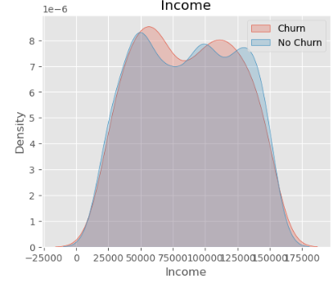
Churn Vs Features(Contd.)
Checking Churn with respect to features
Customers with high income are more likely to churn
7. Income

Slide 14
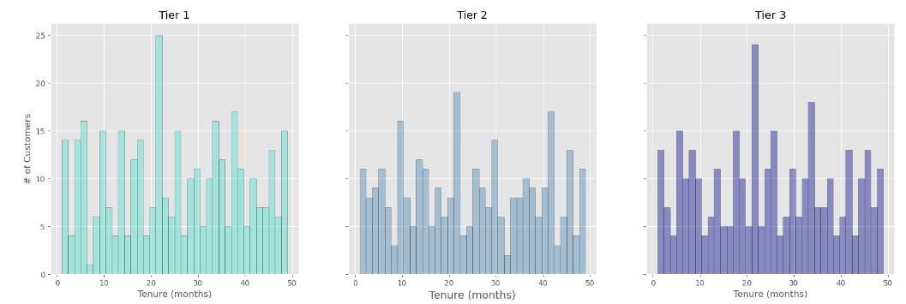
CUSTOMERS BY CONTRACT TYPE
As we can see the Contract_type=0 (tier 1) customers do not stay more than 24 months period
Similarly we can see Tier 3 customers also do not stay more than 24 months
Tier 2 customers tend to be more stable though we see a downfall in #customers after 24 months

Slide 15
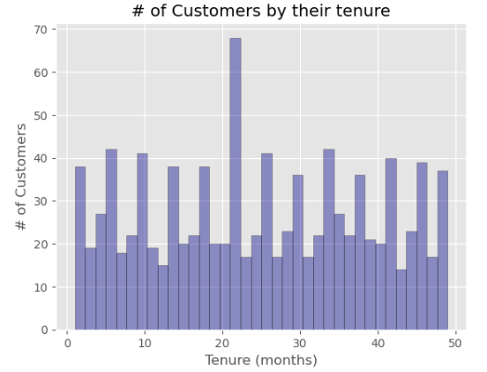
CUSTOMERS BY TENURE
As we can see there is more downfall in count of customers after a period of 24 months or 2 years

Slide 16
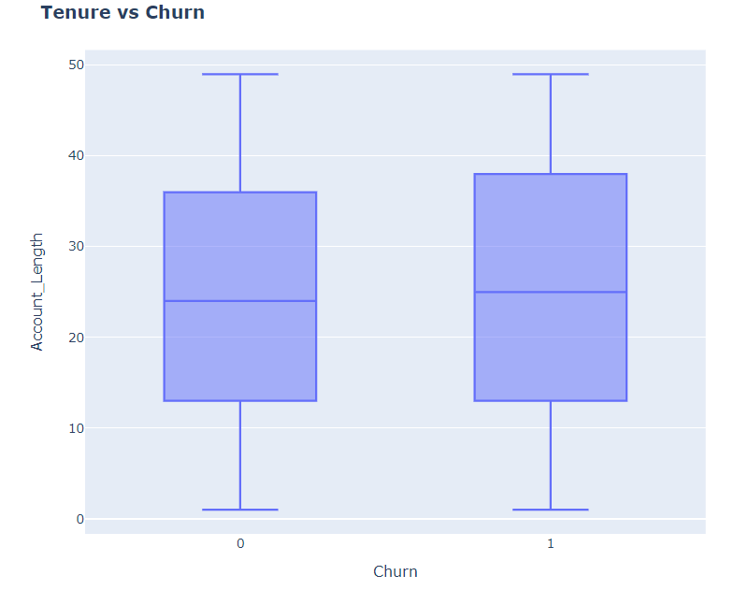
Tenure Vs Churn
The tenure spent by the customer with the telecom service provider is denote by the Account_Length (months). Here it is represented in terms of box plot to understand the effect of tenure w.r.t Churn. For slightly more tenure we see Churn=Yes compared to Non-Churn

Slide 17
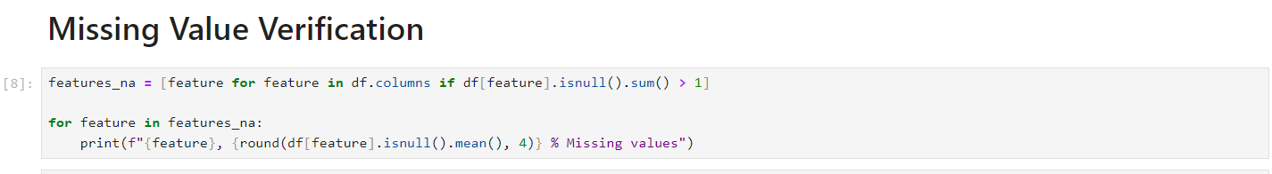
Missing Value Verification
There are no missing value in the dataset

Slide 18
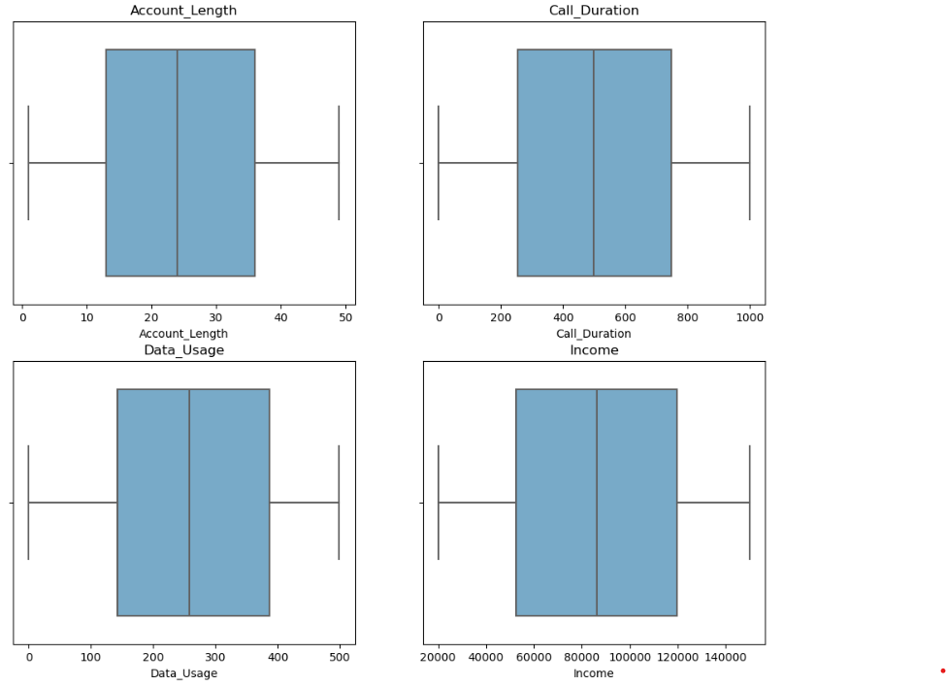
Outlier Detection
There are no outliers in the dataset

Slide 19
FEATURE ENGINEERING

Slide 20
Feature Engineering
Raw data can be transformed into features that are best suited for machine learning models . This technique is called feature engineering. The aim of feature engineering is to make a machine learning model learn better and get more accuracy.
We have the following feature engineering
Encoding of categorical variables – Which has already been done in the supplied data
Feature Selection for Categorical Variables
Feature Selection for Numerical Variables
Feature Scaling for scaling numerical variables
Correlation Analysis
Concluding remarks
We have used Standard scalar for standardizing the numerical features
Correlation analysis shows a strong positive correlation between features-
Income –with- Call duration/Data Usage
Call Duration-with- Data Usage
All the features seem to be positively correlated with the target variable “Churn”

Slide 21
Encoding Categorical Variables
We can also see that all the categorical variables have been already encoded in binary
Gender- Encoded as 0/1 where Male is 0 and Female is 1
Contract_Type encoded as 0,1,2 based on tier 1/tier 2 /tier 3
So we do not need to implement encoding techniques here.
Ideally we will be using one of the below encoding techniques in case data was not encoded:
Label Encoding – When we have 2 categories
One Hot Encoding- When there are more than 2 categories

Slide 22
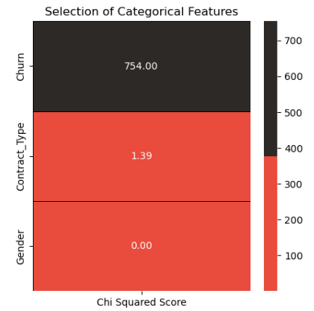
Feature Selection for Categorical Variables
We can see that Gender and Contract Type display a very low relation with Churn using chi-squared test

Slide 23
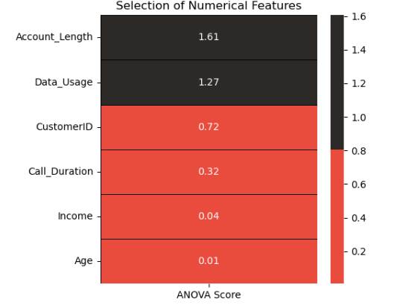
Feature Selection for Numerical Variables
According to the ANOVA test, higher the value of the ANOVA score, higher the importance of the feature.
From the above results, we need to include all the numerical features for modeling.

Slide 24
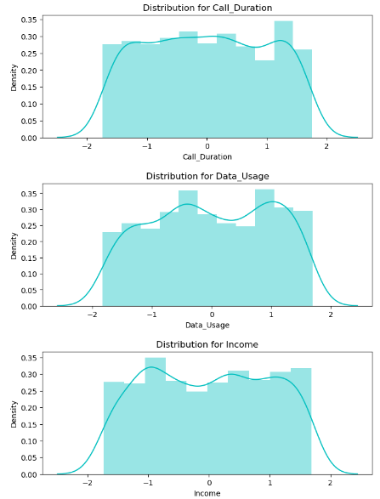
Feature Scaling of Numerical Variables
We have used two techniques:
Standard Scalar- Standard Scaler follows Standard Normal Distribution (SND). Therefore, it makes mean = 0 and scales the data to unit variance. Since the numerical features are distributed over different value ranges, I will use standard scalar to scale them down to the same range. This we will use in final dataset for training
Min Max Scalar
Note: We have 2 options for data scaling : 1) Normalization 2) Standardization.
As most of the algorithms assume the data to be normally (Gaussian) distributed, Normalization is done for features whose data does not display normal distribution and standardization is carried out for features that are normally distributed where their values are huge or very small as compared to other features.
Normalization : Call_Duration, Data_Usage and Income features are normalized as they displayed a right skewed, and bimodal data, and left skewed distribution.
Standardization : None of the features are standardized for the above data.

Slide 25
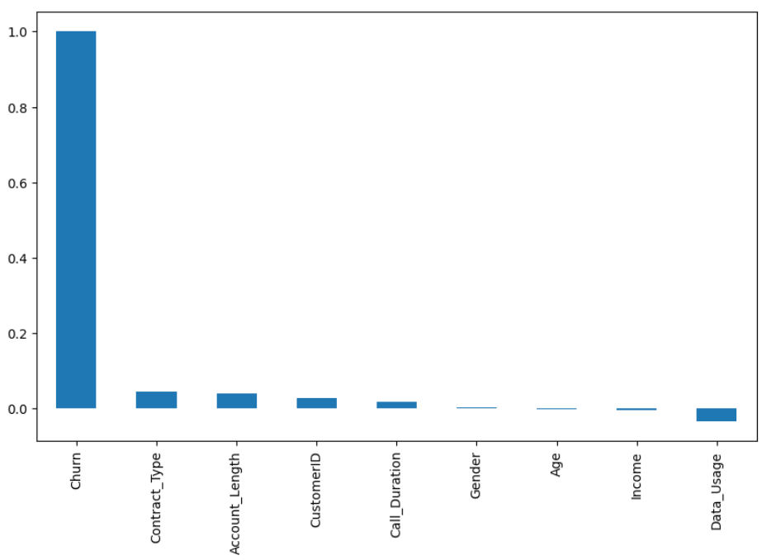
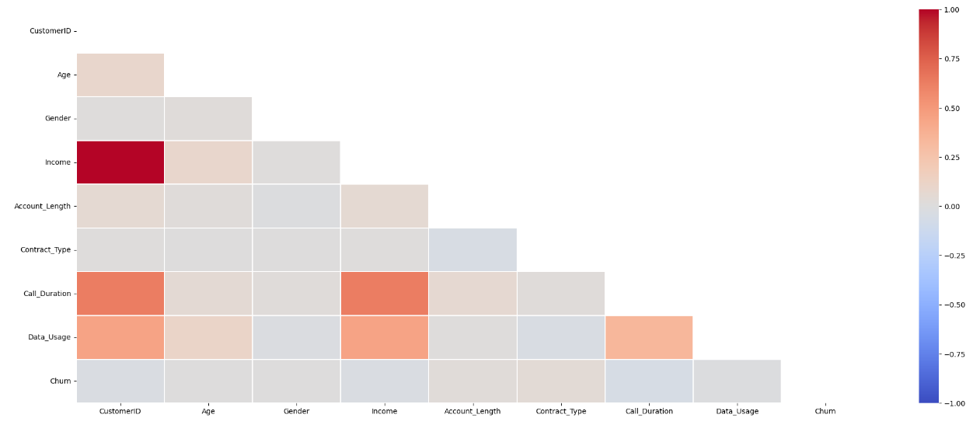
Correlation between features
Checking correlation of features with target variable and correlation between the variables

Slide 26
MODEL BUILDING

Slide 27
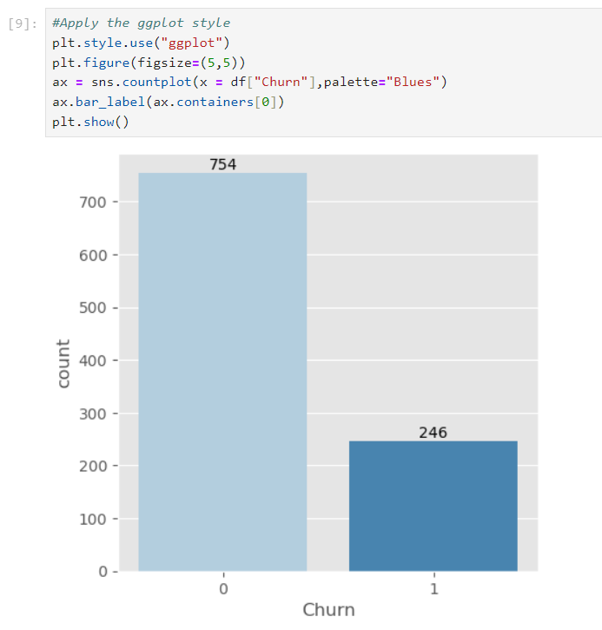
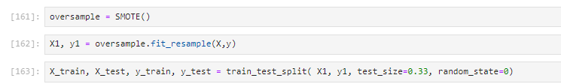
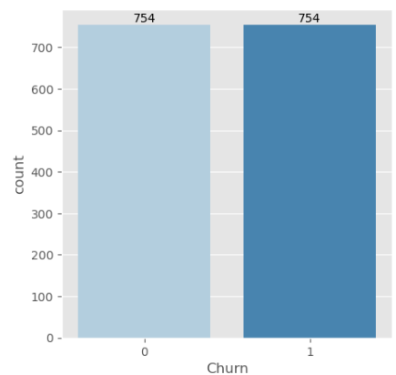
Handling Imbalanced Target Class
Understanding the target variable
As we can see the target variable Churn for prediction is imbalanced because both churn = yes or no are not equally distributed
Some techniques to overcome the imbalanced dataset:
Resampling (oversampling/undersampling)
SMOTE

Slide 28
Model Building
We will be showcasing
Train Test Split chosen- We have chosen 67% Train and 33% Split
Models built and evaluated
K-Nearest Neighbour
SVM
Random Forest Classifier- Chosen as final model with hyper parameter tuning
Gradient Boosting Classifier
Ada Boosting Classifier
Logistic Regression
Decision Tree
3. Model Evaluation
For evaluating the model we use some metrics evaluation such as:
Confusion Matrix
Accuracy Score
ROC Curve
AUC (for ROC)
Precision-Recall-Curve
F1 Score

Slide 29
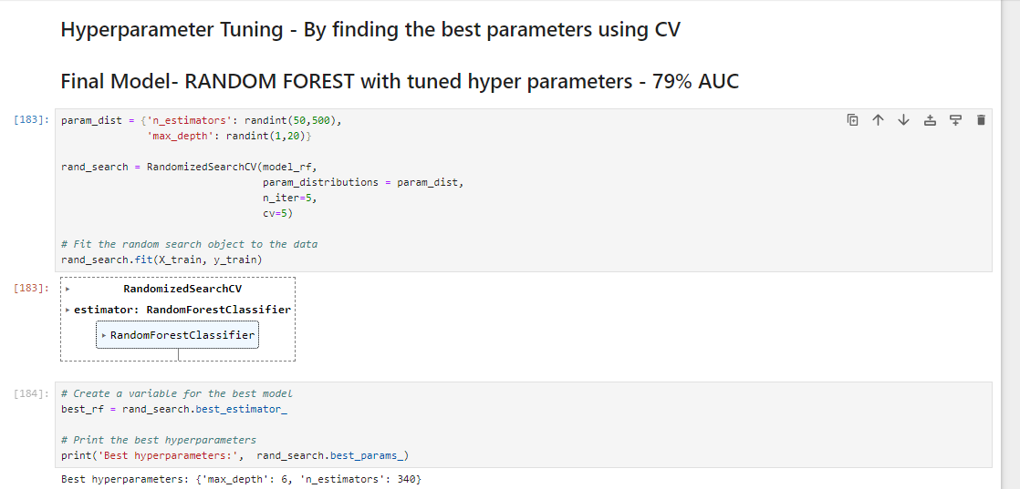
Final Model
I have done hyper parameter tuning using CV and used random forest as my final model

Slide 30
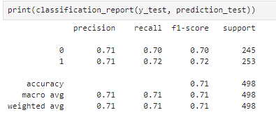
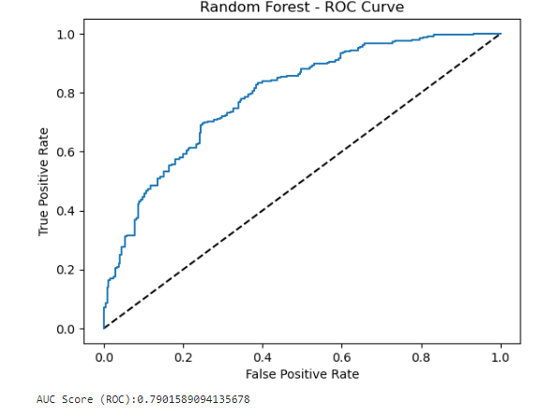
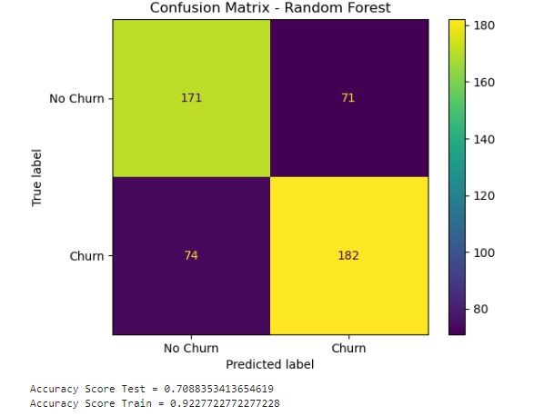
Final Model with AUC at 79%
Evaluation metrics as below
AUC at 79%
Accuracy at 70% for test data
Precision and Recall as depicted

Slide 31
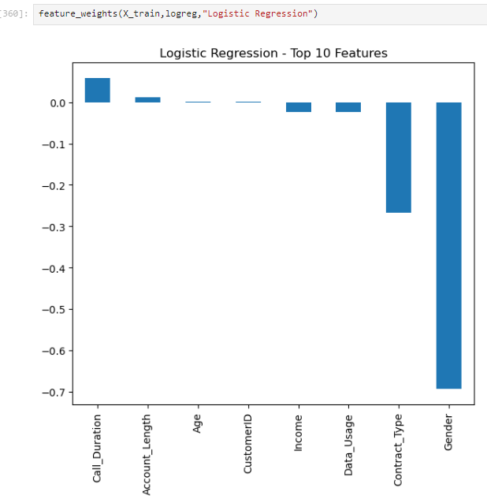
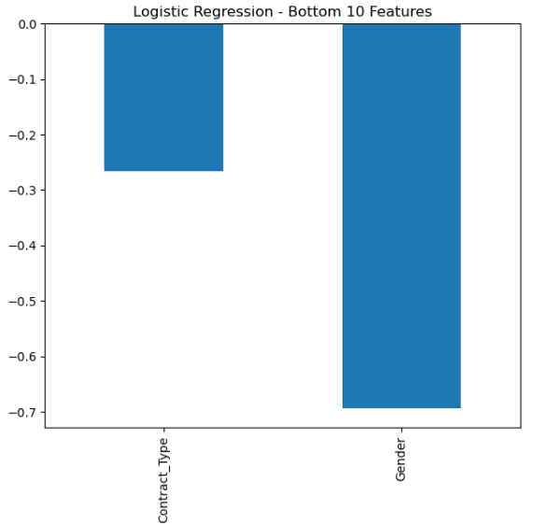
Feature Weights- Logistic regression

Slide 32
DATA ANALYTICS/INSIGHTS

Slide 33
Actionable Insights
The Telecom company needs to focus on customers who are in Tier 1 post a 24month/2year period to keep track and get feedback
The Telecom company should focus and provide more plan for the low to mid-income category
They should also focus on people who use Data Usage more to enhance the internet services
Age Category in range of 50 years are more likely to churn and they should target those customers
Note: Charges paid by the customer could have helped in better determining Churn- EG: Monthly/Yearly Charges

Slide 34
Actionable Insights
The prediction could flow into reports to help us derive actionable insights for the customers that are at risk
We could derive reports like
Percentage of customers by churn reasons
Churn by contract type
Churn by gender
Churn by region/demographics
Churn by age
Churn by data plan

Slide 35
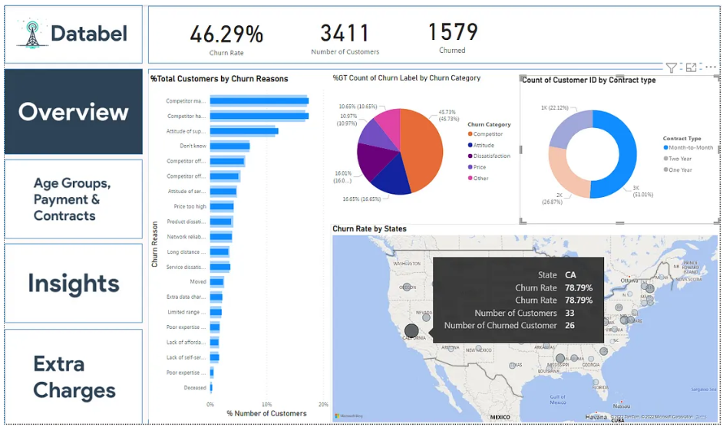
Actionable Insights
A sample report example as below from internet link- https://medium.com/@obalanatosin16/case-study-analyzing-customer-churn-in-power-bi-8f45ca3b702a

Slide 36
Thank you

